Slide 1








Location: Building Name: Room XXX
Hazards / Warnings: | Hazards / Warnings Description: No Eating, Drinking or Smoking Safety Glasses Required Oxidizers Pyrophorics Gases Under Pressure Corrosives Organic Peroxides Skin Sensitizer
Primary Area Contact: | Add Name(s) & Phone Numbers
Secondary Area Contact | Add Name(s) & Phone Numbers
Department Head | Add Name & Phone Numbers
Other Contact as appropriate (i.e Building Monitor, RSO, other) [modify row as needed] | Add Name & Phone Numbers
Environmental Health & Safety: | 646-3327 (Monday - Friday, 8:00-5:00) 646-3311 (after-hours)
Fire/Police/Ambulance: | 911

Slide 2






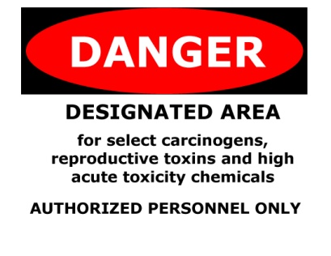









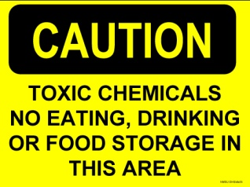



Slide 3
















